Slide 1
Comparative Analysis of Beam Irradiance, Diffuse Irradiance, and Plane of Array Irradiance on DC Output in Solar Systems to predict what feature has the most effect on DC Output
Notes:
I decided to work on the data that was provided to me for my interview last month. Since many different analysis came to my mind

Slide 2
Abstract:
This thesis investigates the impact of different irradiance components, including beam irradiance, plane of array irradiance, and diffuse irradiance, on the direct current (DC) output of solar photovoltaic systems. Through comprehensive data analysis and statistical modeling, this research aims to provide insights into the relative influence of these irradiance factors on the performance of solar energy generation systems.
Notes:
There are numerous environmental factors that could affect the amount of light absorbed by solar panel cells.

Slide 3
Beam Irradiance (Direct Irradiance):
Beam irradiance represents the direct sunlight that reaches the solar panel without any scattering or diffusion. It consists of sunlight that travels in a straight line from the sun to the solar panel surface.
This component of irradiance is most significant when the sun is high in the sky, such as during clear, sunny days with minimal cloud cover.
Beam irradiance is responsible for producing the highest amount of energy in solar panels because it provides direct and concentrated sunlight.
Notes:
direct irradiance refers to the solar radiation that reaches a surface directly from the sun without being diffused or scattered by the atmosphere.

Slide 4
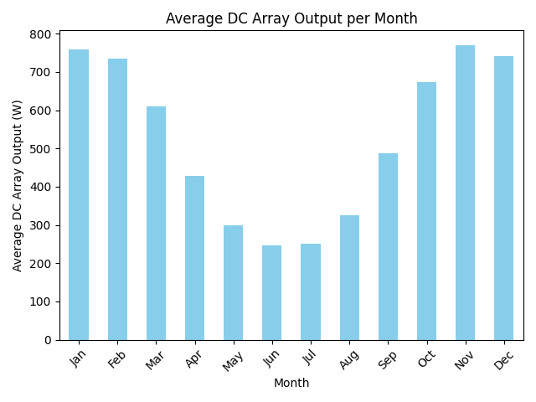
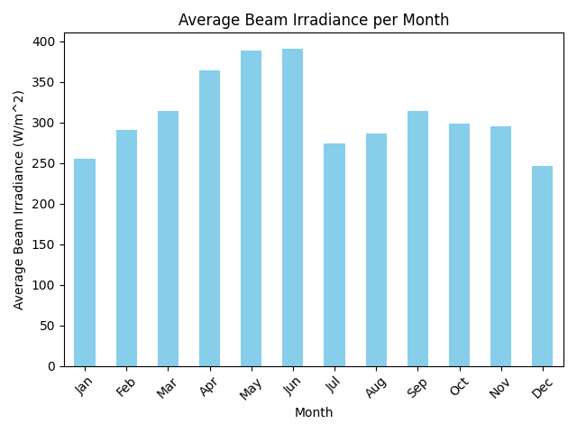

Slide 5
Diffuse Irradiance:
Diffuse irradiance refers to sunlight that is scattered or diffused by atmospheric particles, such as clouds, dust, and water vapor, before reaching the solar panel surface.
Unlike beam irradiance, which follows a direct path from the sun, diffuse irradiance arrives at the solar panel from various directions due to scattering.
Diffuse irradiance is present even on cloudy or overcast days when direct sunlight is limited. It contributes to the overall solar energy generation, albeit at a lower intensity compared to beam irradiance.

Slide 6
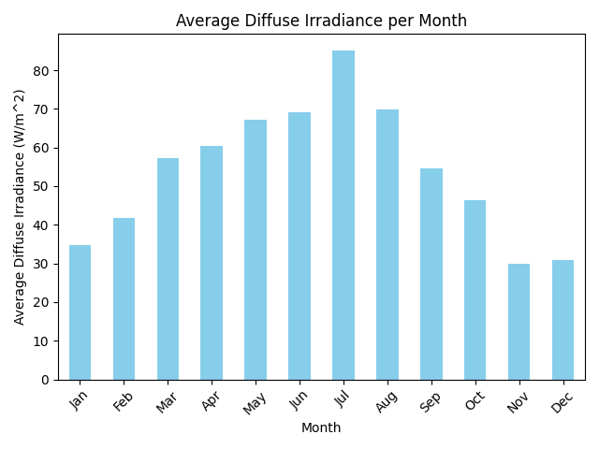
Notes:
We can observe the seasonal trends in both diffuse irradiance and DC output. For example, diffuse irradiance tends to increase from winter months (e.g., January) to summer months (e.g., July), which is consistent with the higher solar radiation typically experienced during summer. Conversely, DC output shows a different trend, with higher values during winter months and lower values during summer. This could be attributed to factors such as temperature, which affects the efficiency of solar panels.

Slide 7
Plane of Array Irradiance (Total Irradiance):
Plane of array irradiance represents the total solar irradiance incident on the surface of the solar panel, accounting for both beam and diffuse components.
It considers the combined effect of direct sunlight (beam irradiance) and scattered sunlight (diffuse irradiance) on the solar panel surface.
Plane of array irradiance is crucial for assessing the overall performance and output of solar panels, as it provides a comprehensive measure of the available solar energy for electricity generation.
Notes:
Plane of array irradiance refers to the total solar radiation incident on the surface of a solar panel, accounting for both direct and diffuse components of sunlight, and is a crucial factor in determining the energy output of photovoltaic systems. It represents the effective irradiance experienced by solar panels and directly impacts their electrical performance and efficiency.

Slide 8
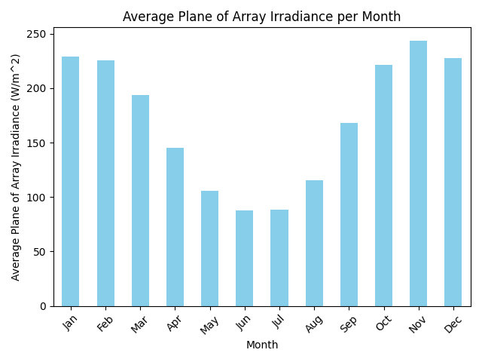

Slide 9
Correlation analysis
To gain deeper insights into the relationship between each type of Irradiance and DC output, correlation analysis was employed.
A strong positive correlation between beam irradiance and DC output would indicate that higher levels of direct solar radiation lead to higher DC output, while a weak or negative correlation could suggest other factors influencing DC output, such as system losses or inefficiencies.

Slide 10
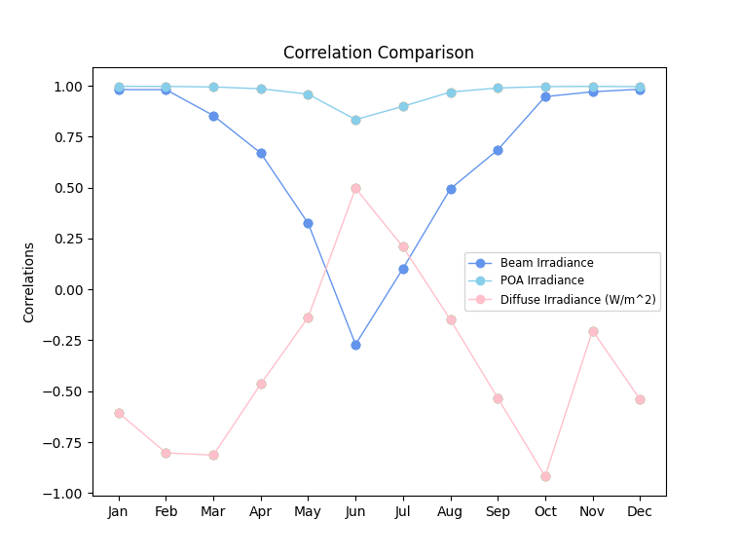
Correlation
Notes:
as diagram shows the relationship between three different types of irradiance and DC output. We see that the light blue data points representing Plane of Array (POA) irradiance have the most significant impact on DC output, as an increase in POA irradiance corresponds to a rise in DC output.
On the other hand, the pink data points representing Diffuse irradiance exhibit an almost opposite relationship with DC output. As Diffuse irradiance increases, DC output tends to decrease, and vice versa.

Slide 11
Regression Analysis
Used multiple linear regression with DC output as the dependent variable and beam irradiance, plane of array irradiance, and diffuse irradiance as independent variables. Fit the regression model to the data and assess the coefficients of the independent variables.
Interpret the coefficients to understand the relative importance of each irradiance component in predicting DC output. A higher coefficient magnitude indicates a stronger influence on DC output. ensemble random forests model to calculate the feature importance of POA, Beam, and Diffuse on DC output and compare the importance scores to determine which irradiance component has the most significant impact on DC output prediction
Notes:
Utilized multiple linear regression with DC output as the dependent variable and included beam irradiance, plane of array irradiance, and diffuse irradiance as independent variables.

Slide 12
Coefficients:
The coefficients represent the change in the target variable (DC output) for a one-unit change in each predictor variable (diffuse irradiance, plane of array irradiance, beam irradiance), holding other variables constant.
The coefficients are as follows:
Diffuse Irradiance: -1.029
Plane of Array Irradiance: 3.117
Beam Irradiance: -0.193
Positive coefficients indicate that an increase in the corresponding predictor variable leads to an increase in DC output, while negative coefficients indicate the opposite.
Notes:
To understand the importance of each irradiance component on DC output, I conducted a regression analysis to find the trend. This trend analysis shows us the effect of POA parameter is 3 times more than diffuse and beam.
Interpret the coefficients to discern the relative importance of each irradiance component in predicting DC output. A higher coefficient magnitude signifies a stronger influence on DC output.
This also shows us that for future focusing on POA would be more impactful on the DC output.

Slide 13
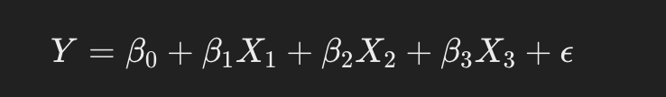
Trend Analysis, predicting the dependent variable
DC Output =−1.029×Diffuse Irradiance+3.117×Plane of Array Irradiance−0.193×Beam Irradiance
Notes:
In order to have a Trend Analysis, i analysing the dependent variable from regression method. This gives us to find the impact of each coefficient values to the DC output

Slide 14
Feature Importances:
Feature importances represent the relative importance of each predictor variable in predicting the target variable (DC output) based on a machine learning model (Random Forest Regressor).
The feature importances are as follows:
Diffuse Irradiance: 0.285
Plane of Array Irradiance: 0.680
Beam Irradiance: 0.036
The values represent the proportion of the total reduction in the criterion (e.g., MSE) brought by that feature.
Notes:
Additionally, used random forests model to compute the feature importance of Plane of Array (POA), Beam, and Diffuse irradiance on DC output. By comparing the importance scores, determine which irradiance component exerts the most significant impact on DC output prediction.
Mean square error

Slide 15
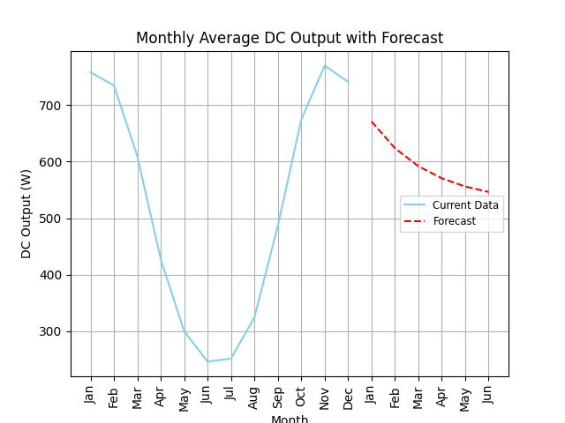
Forecasting
ARIMA, short for Autoregressive Integrated Moving Average, is a forecasting method that combines autoregressive features, differencing for stationarity, and moving average components to analyze and predict future points in time series data. This model excels in handling data with trends or seasonality, making it highly versatile for a wide range of time series forecasting scenarios.
Notes:
For time series used Arima to forecast the DC output value for the next 6 months based on the given data

